Slide 2
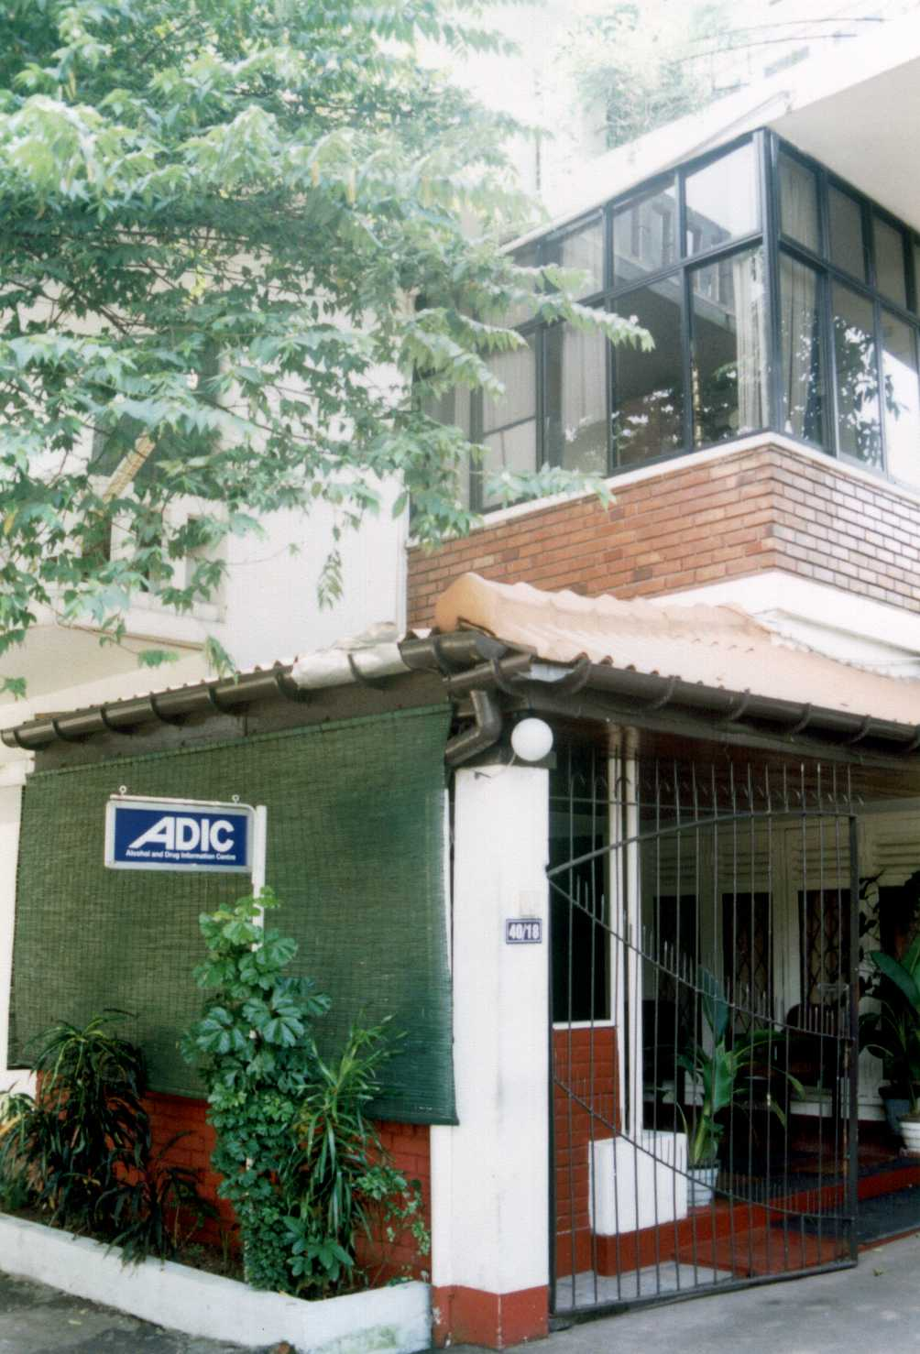
A
DIC
Alcohol and Drug Information Centre
Sri Lanka

